Slide 1
Economics Job Market
Sanket Kanekar
Auburn University
April 24th 2023

Slide 2
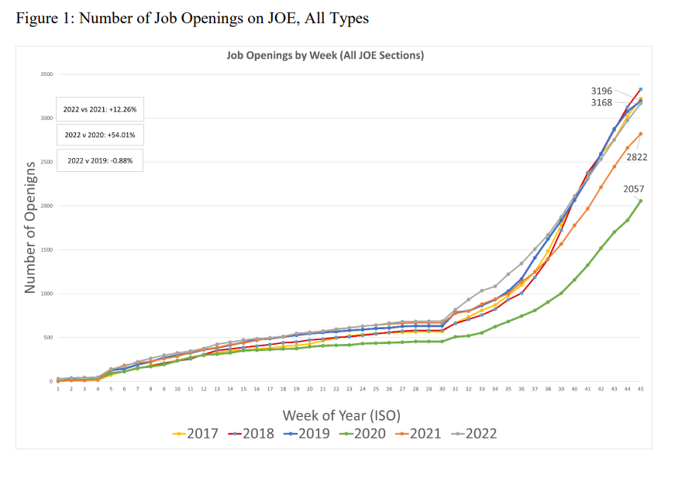

Slide 3
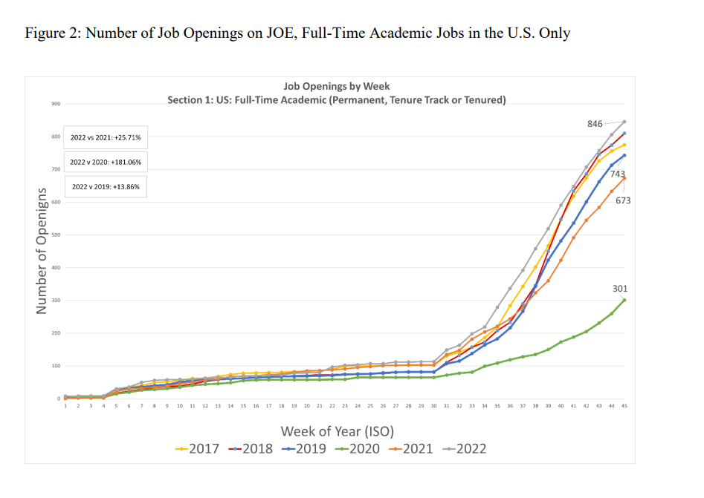

Slide 4
Job Market Paper
Ensure that you have prepared for the job market by no later than November.
While there may be additional steps to take, it is essential to finalize your job market paper.
Once you commence the job market process, there will be no time to work on your paper.

Slide 5
Job Market Materials
CV
Cover Letter
Research Statement
Teaching Statement
Teaching Evaluation
Diversity Statement
Job Market Presentation
Link to the materials
https://github.com/kanekarsanket/Job-Market-Materials

Slide 6
Job Market Website
You should be ready with a website by the latest October.
There are multiple sources to make websites for free.
Github, Google Sites, Wix, etc
https://kanekarsanket.github.io/
Link your website to the Auburn University website. You can ask CLA IT team to do so.

Slide 7
Job
Make a job profile on AEA.
You can search for jobs on the AEA website: https://www.aeaweb.org/joe/listings
Also, there are other websites for job applications.
https://jobs.chronicle.com/
https://www.higheredjobs.com/

Slide 8
Apply for Jobs
My primary focus in job applications was on tenure track positions at universities and colleges.
Typically, I submitted 3-5 job applications daily, recognizing that the process can be quite time-consuming.
Apply for any job that you believe is relevant to your qualifications and experience.
The job application period is from November - December.
Interview invitations are typically received between mid-December and January, with many interviews scheduled for the first week of January.

Slide 9
Application Process
Do your mock interview in December.
Prepare two job market pitches (2-3 mins) and (5-6 mins).
Prepare common questions for the interview.
First interview is mostly for 30 mins.
Interview I received,
First round:
Allegheny College (Tenure Track)
Urban Institute (Researcher)
Elevance Health (Analyst)
Second round
Alabama State University

Slide 10
Fly-Out
The fly-out is usually for one day.
Ensure that you have your clothing or outfit ready.
It is a tiring process, so make sure you have a good sleep and food.
Be prepared to communicate for a long time.
Make sure you know each thing you mentioned in your application.
It’s better to take some energy drink or juice with you.
Be yourself and connect with the faculty.
Give your best.

Slide 11
Interview Preparation
You should know everything about the College/Company.
You should prepare all the HR questions you can easily find online.

Slide 12
Interview Questions
Questions from the College Interview:
How would you approach your teaching in liberal arts college?
How would you balance your research and teaching?
We are introducing a Master's program in healthcare economics, so how will you introduce this course to the program?
Your teaching philosophy and strength?
Would you focus more on economic intuition or application?
How would you explain your research to the student who is in first year?
How would your colleague describe you?
How would you advise students on the project?

Slide 13
Interview Questions:
Research Institute
Tell me about yourself
Rest of the time, I was talking about my research
Industry Job
Everything on my CV

Slide 14
Interview Questions
Alabama State University.
Research questions.
Teaching experience and questions related to it.
1) What classes can you teach? The textbook I will use?
2) Everything on CV.

Slide 15
Overview
Tell your advisor during Fall/Summer you will be in the job market.
Tell your committee that you will be in job market and you will need a reference letter.
Prepare all the materials by the end of October.
Apply.
Enjoy the process and accept the offer.
Get ready for the dissertation.
Done.

Slide 16
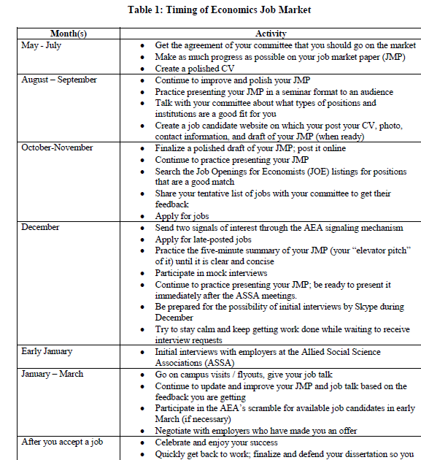

Slide 17
Thank You
Good luck on your job market search.
There will be many rejection emails but don’t get upset. You need one job at the end.
Stay connected.
Contact me if you have any questions.
Email: sanketkanekar08@gmail.com

